Slide 1
Lecture 11 Convolution
Kyu Ho Park
May 2, 2017
Ref: Programming Massively Parallel Processors, Kirk and Hwu
and Image Convolution with CUDA, V.Podlozhnyuk,NVIDIA

Slide 2
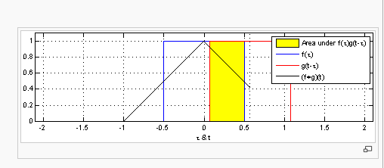
Convolution
H(m)=
(F*G)(m)=∑F(n)G(m-n)
n

Slide 3
1D Convolution
F[0]
F[7]
F
1 | 2 | 3 | 4 | 5 | 6 | 7 | 8
*
G[0]
G[4]
G
window
1 | 2 | 3 | 2 | 1
=
1 | 4 | 9 | 8 | 5
∑
H[0]
H
 |  | 27

Slide 4
1D Convolution
H[2]=F[0]*G[0]+F[1]*G[1]+F[2]*G[2]+F[3]*G[3]+F[4]*G[4]
=27
H[i]=F[i-2]*G[0]+F[i-1]*G[1]+F[i]*G[2]+F[i+1]*G[3]+F[i+2]*G[4],
H[0]=F[-2]*G[0]+F[-1]*G[1]+F[0]*G[2]+F[1]*G[3]+F[2]*G[4],
where F[-2] and F[-1] do not exist and they are called ‘ghost elements’. The ghost elements exist for the F[8] and F[9] in the example at the previous slide.
ghost element F[-2] F[-1] F[8] F[9] <-> halo element
The values of the ghost elements are assumed to be 0 here.

Slide 5
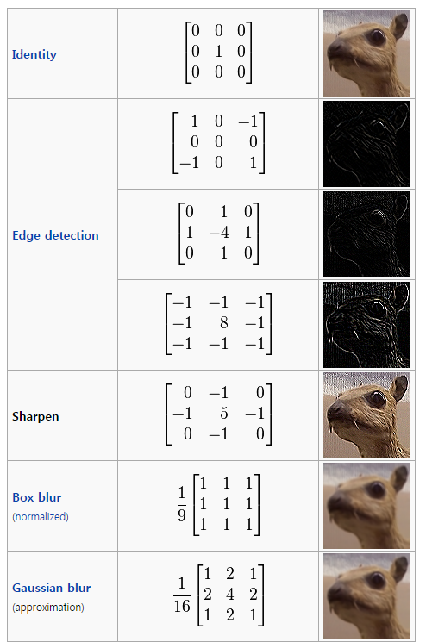
2D Convolution
high filter
low filter

Slide 6
2D Convolution
1 | 2 | 3 | 4 | 5 | 6 | 7 | 8
2 | 3 | 4 | 5 | 6 | 7 | 8 | 9
3 | 4 | 5 | 6 | 7 | 8 | 9 | 1
4 | 5 | 6 | 7 | 8 | 8 | 1 | 2
5 | 6 | 7 | 8 | 9 | 1 | 2 | 3
6 | 7 | 8 | 9 | 1 | 2 | 3 | 4
7 | 8 | 9 | 1 | 2 | 3 | 4 | 5
8 | 9 | 1 | 2 | 3 | 4 | 5 | 6
 |  | 321
*
1 | 2 | 3 | 2 | 1
2 | 3 | 4 | 3 | 2
3 | 4 | 5 | 4 | 3
2 | 3 | 4 | 3 | 2
1 | 2 | 3 | 2 | 1
1 | 4 | 9 | 8 | 5
4 | 9 | 16 | 15 | 12
9 | 16 | 20 | 24 | 21
8 | 15 | 24 | 21 | 16
5 | 12 | 21 | 16 | 9
∑
=

Slide 7
1D Parallel Convolution
Step1: Set up the function signature.
/*Function signature: the combination of the function name and the parameter list. */
__global__ void convolution(float *F, float *G, float *H, int mask_size, int data_size) { }
Step 2: Mapping of threads to output elements.
Organize the threads in 1D grid and each thread calculate one output.

Slide 8
Step 3:Index of H
int i=blockIdx.x*blockDim.x + threadIdx.x;
Step 4: calculation of H[i]
mask_size: 2*n+1,
H[i]=F[i-n]*G[0] + F[i-n+1]*G[1]+……
+F[i+n]*G[2*n];

Slide 9
float Hvalue=0;
int F_start=i-(mask_size/2);
for( int j=0;j<mask_size; j++){
if(F_start +j>=0 && F_start+j< data_size){
Hvalue+=F[F_start + j]*G[j];
}
H[i]=Hvalue;
}

Slide 10
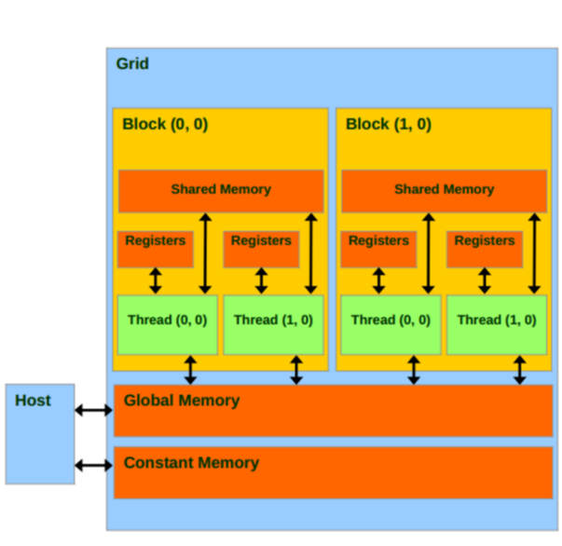
CUDA Memory Model

Slide 11
Constant Memory and Cacheing
Convolution:
-size of the Mask G is small
-the values of G array are not changed during the execution of kernel.
-all threads need to access the mask elements.
-all threads access the mask G elements in the same order.

Slide 12
CUDA Memory Architecture
Grid
Block 0
Block 1
공유메모리
(Shared Memory)
공유메모리
(Shared Memory)
Register
Register
Register
Register
Thread 0
Thread 1
Thread 0
Thread 1
Host
Global Memory
Constant Memory
Texture Memory

Slide 13
Constant Memory
Constant Memory: A read-only special purpose memory accessible uniformly by threads in a warp.
It is read-only for kernels, the host can read and write it.
It is in device DRAM and has a dedicated on-chip cache whose size is 64KB per SM.
It is best if all threads in a warp access the same location in constant memory. Accesses to different addresses by threads within a warp are serialized.
Constant memory variable qualifier: It must be declared in global scope. It can be accessible from all threads within a grid and from the host through runtime functions.
__constant__

Slide 14
constant memory variable initialization
cudaError_t cudaMemcpyToSymbol(const void *symbol, const void *src, size_t count, size_t offset, cudaMemcpyKind kind)
//copy the data pointed to by src to the constant memory location specified by symbol on the device.

Slide 15
constant memory for the mask G
#define mask_size 5;
__constant__ float G[mask_size];
cudaMemcpyToSymbol(G, host_G,mask_size*sizeof(float));
//host_G: G array in the host memory.

Slide 16
Tiled 1D Convolution
Threads collaborate to load input elements onto an on-chip memory and access the on-chip memory for their subsequent use of these elements.
Assume that each thread calculates one output, H[i]. A block with 1024 threads can process up to 1024 data elements.
Output tile: the collection of output elements processed by each block.

Slide 17
Tiled Approach
Purpose: Reducing the total number of global memory accesses.
mask_size: 2n+1, an odd number.
halo elements: the elements that are involved in multiple tiles and loaded by multiple blocks.

Slide 18
Output tile
F[0]
F[15]
0 | 1 | 2 | 3 | 4 | 5 | 6 | 7 | 8 | 9 | 10 | 11 | 12 | 13 | 14 | 15
Block 0
Block 1
Block 2
Block 3
Tile 0
 |  | 0 | 1 | 2 | 3 | 4 | 5
ghost
halo
H[0]~H[3]
Tile 1
2 | 3 | 4 | 5 | 6 | 7 | 8 | 9
halo
Tile 2
6 | 7 | 8 | 9 | 10 | 11 | 12 | 13
10 | 11 | 12 | 13 | 14 | 15
H[12]~H[15]
Tile 3
ghost

Slide 19
Tiled Convolution
Input tile is loaded into shared memory
__shared__ float F_sm[tile_size+mask_size-1];
Loading the left halo element:
int halo_index_left = (blockIdx.x-1)*blockDim.x + threadIdx.x;
if(threadIdx.x >=blockDim.x-n){
F_sm[threadIdx.x-(blockDim.x-n)]=
(halo_index_left<0)?0:F[halo_index_left];
}

Slide 20
Tiled Convolution
Loading the center elements of the input tile:
F_sm[n+threadIdx.x]=F[blockIdx.x*blockDim.x + threadIdx.x];
Loading the right halo elements:
int halo_index_right=(blockIdx.x+1)*blockDim.x+threadIdx.x;
if(threadIdx.x<n){
F_sm[n+blockDim.x+threadIdx.x]=
(halo_index_right>=data_size)?0:F[halo_index_right];
}

Slide 21
Each thread will use
F_sm[threadIdx.x] ~ F_sm[threadIdx.x+Mask_size-1]
Convolution Calculation:
float Hvalue=0;
for(int j=0;j<Mask_size; j++){
Hvalue+=F_sm[threadIdx.x+j]*G[j];
}
H[i]=Hvalue;

Slide 22
1D Naïve Convolution
For thread blocks that do not handle ghost elements:
The number of F elements accessed by each thread is mask_size.
Thus,the total number of F elements accessed by each thread block is blockDim.x*mask_size( =blockDim.x*(2n+1)).
For the first and last blocks, the threads that handle ghost elements:
No memory access is done for the ghost elements, which reduce the number of memory accesses.

Slide 23
Tiled Convoluton
0 | 0 | F[0] | F[1] | F[2] | F[3] | F[4] | F[5] | F[6] | F[7] | 0 | 0
H[0]
H[1]
H[2]
H[7]

Slide 24
Tiled Convolution
Number of ghost elements is n, and the number of threads that use each of these ghost elements is 1,2,3,…,n= n(n+1)/2.
The number of accesses avoided due to ghost elements is n(n+1).
Total number of memory accesses for F by tiled kernel:
For the internal thread blocks, we have to load (blockDim.x+2n)
F-element to the shared memory,
For the boundary thread blocks, we have to load (blockDim.x+n)
F-element to the shared memory.

Slide 25
Ratio of Memory accesses
For internal thread blocks,
[blockDim.x*(2n+1)]/(blockDim.x+2n).
For the boundary blocks,
[blockDim.x*(2n+1)-n(n+1)/2]/(blockDim.x+n).
In general blockDim.x is much much larger than n,
above ratios can be approximated by (2n+1)=mask_size.

Slide 26
Presentation List
Matrix Multiplication with CUDA, Robert Hochberg,2012: 김태경
Deep Learning Tutorial, Pater Sadowski,2015: Romain Renard
Image Processing with CUDA,Jia Tse,2006: 기세환
Image Convolution with CUDA,Victor Podlozhnyuk,2007: 정휘영
NVIDIA Profiler User’s Guide, NVIDIA: 강상훈
Optimizing Matrix Transpose in CUDA,NVIDIA:김혜지
GPU performance analysis and optimization by Paulius Micikevicius, NVIDIA: 이진수
Optimizing for CUDA by Andreas Moshovos: 김세연
Numerical Solution of Partial Differential Equations :한승열
CUDA Accelerated Monte-Carlo For HPC,Andrew Sheppard: 김영석

Slide 27
11. Accelerating Genetic Algorithm Using GPGPU and CUDA,R.S. Singh et al.
:김용신
12. Accelerating Steady-State Genetic Algorithms based on CUDA : 김훈
13. Introducing NVIDIA cuDNN, Sharan Chetlur: 김재엽
14. Deep Learning, Alison B Lowndes, NVIDIA: 유찬희
15. Fast Fourier Transform and CUFFT Library: 서준
16. Sparse Matrix-Vector Product and CUDA : 이준희

Slide 28
Topics to be covered
1. Introduction
2. CUDA C Programming
3. CUDA Execution Model I
4. CUDA Execution Model II
5. CUDA Memory Architecture
6. CUDA Global Memory
7. CUDA Shared Memory
8. Parallel Reduction
9. Streams and Events
10. CUDA Instructions
11. Convolution
12. CUDA Parallel Prefix Sum
13. Sparse Matrix-Vector Multiplication
14. Introduction to OpenACC
15. Introduction to OpenCL
16. CUDA and MPI
17. CUDA Thrust Template Library
18. CUDA Program Implementation and Debugging

Slide 29
Description of Term Project
1. Evaluation Guideline:
Homework( 5 Homeworks) : 30%
Term Project : 20%
Presentations : 10%
Mid-term Exam : 15%
Final Exam : 25%
2.Schedule:
(1) May 18:
Proposal Presentation
(2)June 1:
Progress Report & Presentation
(3)June 22:
Final Report Submission
3.Project Guidelines:
Team base( 2 students/team)
Subject: Free to choose
Show your implementation
a. in C
b. in CUDA C
c. in OpenCL(optional)
(4) You have to analyze and explain the performance of each implementation with the detailed description of your design.

